Slide 1
Machine Learning Fundamentals
Pierre Baume - 2018-11-13

Slide 2
How can we answer some simple questions about the data put in our care?

Slide 3
Table of Contents
A couple of graphs
A question or 2
A pair of columns
A tale of 2 classifications
A tale of 2 regressions
A conclusion and beyond
Not that there’s that much ;)

Slide 4
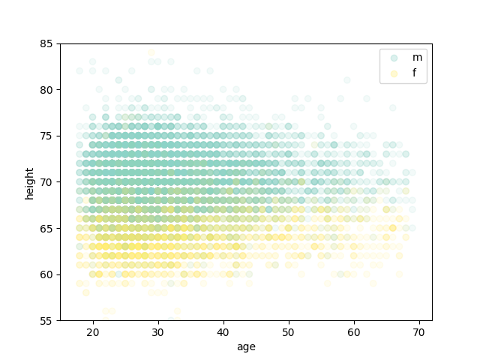
Height vs Age with Sex colormap
Scatter plot limited to ages 15-72 (15 for better framing, 72 because there’s few points beyond that)
Extremes of heights also removed from the plot, to focus on the interesting part
Young people seem to be taller, but hard to prove. Could be an artifact of having more of them in the app

Slide 5
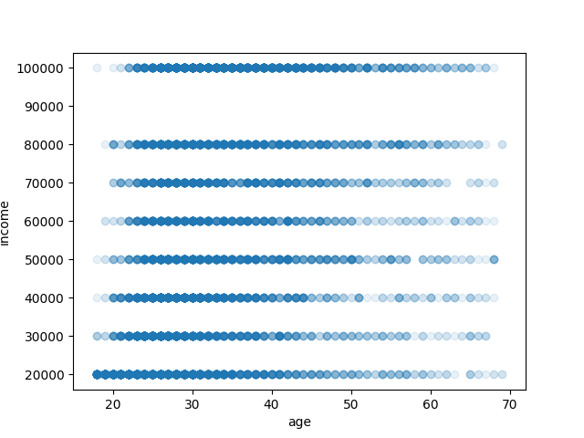
Income vs Age
Scatter plot limited to ages 15-72 (15 to make it look nice, 72 because there’s few points beyond that)
For visual check of a possible correlation
Removed higher incomes, as the correlation is less strong (I did check the corresponding scores)

Slide 6
With little time for complex explorations, we focus our work on numeric columns and sex (easy to code as 0/1). We study correlations between height, income, age and sex. We reuse some pre-written code (thx!) to look at word usage in essays.

Slide 7
First Column
Start from religion column
Code each option as a number based on how serious people are about their religion, from 0 to 5
Graphing the new frequencies shows a bell-like graph, so the encoding seems to makes sense
What about God?

Slide 8
Second Column
Tried to code body type as a single number
Ordering the options was tricky
Maybe the options can be split into weight and fitness, by looking at other columns
Abandoned for lack of time
Back to earth

Slide 9
What’s in a name (or 10 essays)?
We try a simple bag of words approach and see what comes out
We reuse the code provided to convert the NaNs into empty strings, merge the essays and fit the resulting model to the sex column.
We try a few parameters for the vectorizer (removing words too common or too rare), but no improvement.
Outcome
The result is immediately about 80% accurate
Didn’t find the time to build training and test sets :/
No time to run this many times with different training set sizes (sorry)

Slide 10
How do we make more?
We try a simple linear regression
We remove NaNs and non-responses (-1) from the income column.
We pick as inputs a few columns that we coded into numbers.
We scale our inputs with the MinMaxScaler. We split our dataset into a train and a test set. We score the predictions.
Outcome
We observe a correlation on the corresponding scatter plot, but it’s hard to interpret with the score method, as differences in income can produce large numbers
Using scores, we still observe that the results are better for lower incomes. We filter higher income
Each input we added improves the score.

Slide 11
Conclusion
I’m sorry that I didn’t find more time working on the project. There’s much more that I would have liked to explore. I have been traveling about 2 weeks during the time of the lessons, so that didn’t help. Seemingly small things, like adding the color legend to the scatterplot, can easily take an hour or 2 (the first time, hopefully). I also found it awkward to go back to the material and navigate around. I’ll suggest a search function in my feedback. I found it very interesting to see how hard it can be to translate simple questions into useful code. Maybe I struggled a bit too much trying to find correlations, instead of observing their absence. In any case, I learned a lot in the lessons and the guided projects, also about python and the corresponding packages, regardless of how the capstone project went. So I’m very grateful. :D

